Slide 1
Cucumber (Behaviour Driven Development)
Session5 Anshul Sonpure

Slide 2
Topic of discussion
Cucumber Reports
What are Cucumber Reports?
Types of Cucumber Reports
Generating Cucumber Reports
Customizing Cucumber Reports
Cucumber Integration with Selenium
How to integrate Extent report with cucumber

Slide 3
Cucumber Reports
Cucumber Reports provide valuable insights into the execution results of your Cucumber tests, helping you understand the test outcomes and identify any issues or failures. These reports offer various types of information and formats to suit your needs. Let's dive into the details.
What are Cucumber Reports?
Cucumber Reports are generated after executing Cucumber tests and provide a summary of the test results. They include information such as the number of scenarios executed, passed, and failed, along with detailed information about each scenario and step.
Types of Cucumber Reports:
HTML Reports: Cucumber can generate HTML reports that provide a comprehensive view of the test execution. These reports include features, scenarios, and step details along with the corresponding status (passed, failed, skipped).
JSON Reports: Cucumber can generate JSON reports that contain structured data about the test execution results. These reports can be used for further analysis or custom processing.
XML Reports: Cucumber also supports generating XML reports, which can be integrated with other tools or frameworks for reporting purposes.

Slide 4
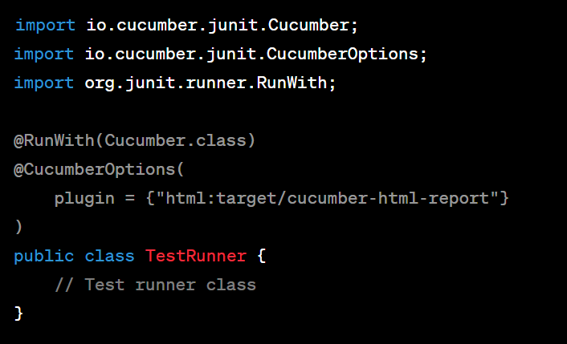
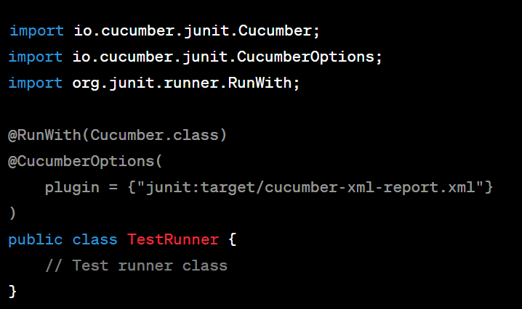
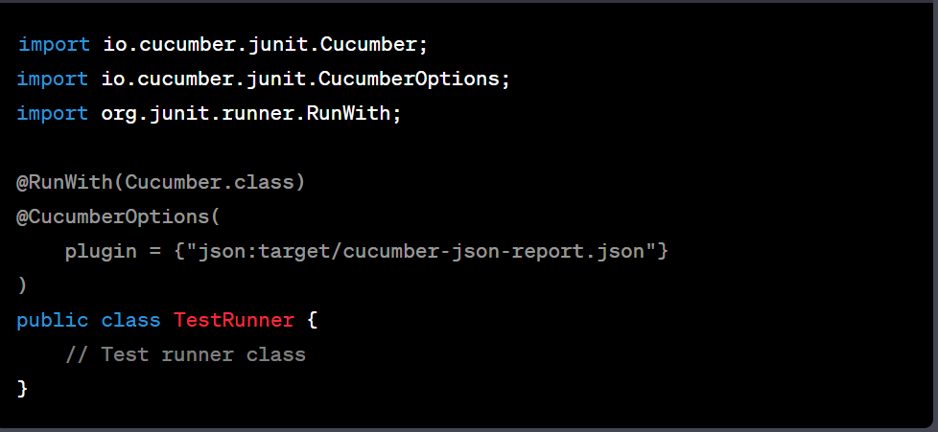
Cucumber Reports
Code for HTML report Code for XML report
Code for JSON report

Slide 5
Generating Cucumber Reports
Generating Cucumber Reports:
To generate Cucumber reports, you need to configure your Cucumber runner class or build automation scripts accordingly. Cucumber supports various plugins and formatters that can be used to generate reports in different formats.
‘@CucumberOptions’ annotation is used to specify the report plugin and its output directory. In this case, the HTML report is generated in the target/cucumber-html-report directory.

Slide 6
Customizing Cucumber reports
Customizing Cucumber reports:
To enhance the visuals and content of Cucumber reports, you can utilize third-party libraries and plugins. For HTML reports, you can use frameworks like Cucumber Extent Report, Cucumber HTML Report, or Cucumber Reporting.
Here's an example of customizing the Cucumber HTML report using the Cucumber Extent Report plugin:
import com.aventstack.extentreports.cucumber.adapter.ExtentCucumberAdapter;
import io.cucumber.junit.Cucumber;
import io.cucumber.junit.CucumberOptions;
import org.junit.runner.RunWith;
@RunWith(Cucumber.class)
@CucumberOptions(
plugin = {"com.aventstack.extentreports.cucumber.adapter.ExtentCucumberAdapter:"}
)
public class TestRunner {
// Test runner class
}
In this example, the com.aventstack.extentreports.cucumber.adapter.ExtentCucumberAdapter plugin is used to generate an enhanced HTML report. The report provides additional features like screenshots, logs, and custom formatting.

Slide 7
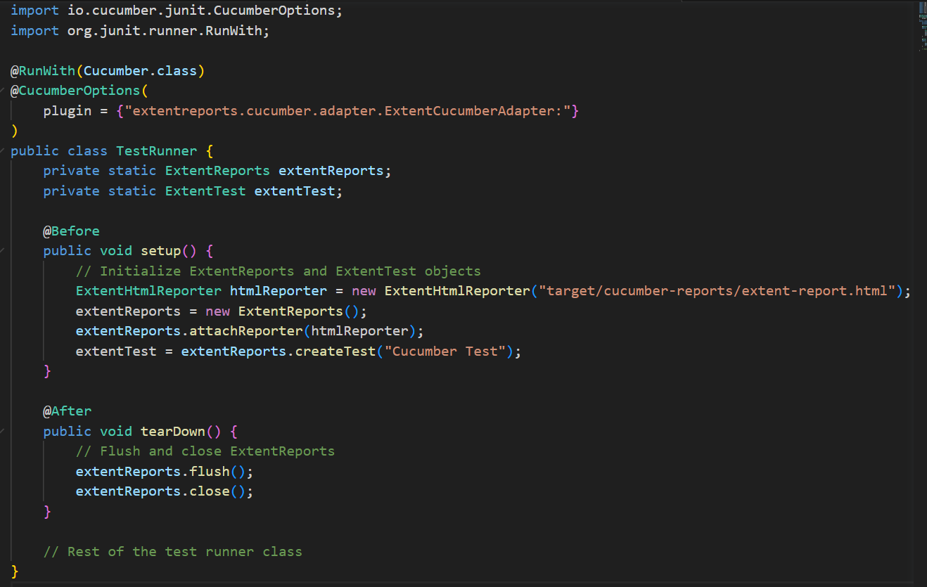
Customizing Cucumber reports
Integrating Extent Reports with Cucumber:
Extent Reports is a popular reporting library that provides detailed and comprehensive reports for test executions. To integrate Extent Reports with Cucumber, you can use libraries like ExtentCucumberFormatter or ExtentReports Cucumber Adapter.
Here's an example of integrating Extent Reports with Cucumber using the ExtentCucumberFormatter plugin:

Slide 8
Summary of topics covered
Cucumber Reports: Cucumber Reports provide detailed insights and summaries of test execution results in a readable format. They help in analyzing and reporting test results effectively.
Types of Cucumber Reports: Cucumber supports various types of reports such as HTML, JSON, XML, and more. These reports can be customized to suit specific needs.
Generating Cucumber Reports: Cucumber generates reports automatically after test execution, providing information about passed, failed, and skipped scenarios, along with detailed step-wise results.
Customizing Cucumber Reports: Cucumber reports can be customized by adding additional information, screenshots, or custom formatting to enhance the readability and clarity of the test results.
Integrating Extent Report with Cucumber: Extent Report is a popular reporting library that can be integrated with Cucumber to generate advanced and interactive reports with rich visuals, charts, and insights. It provides detailed information about test execution and helps in analyzing test coverage and trends

